Slide 1
Guided Capstone Project Presentation
Samuel

Slide 2
Project Overview
Big Mountain suspects it may not be maximizing its returns, relative to its position in the market. It also does not have a strong sense of what facilities matter most to visitors, particularly which ones they're most likely to pay more for.

Slide 3
Project Objective
Build a predictive model for ticket price based on the number of facilities, or properties, boasted by the ski resort market.

Slide 4
Data Wrangling
The data acquired to conduct this project has 330 rows and 27 columns in ski_data data. Columns such as fastEight, yearsOpen, year2019
Out of the 330 rows, 14% were dropped leaving just 277 rows. For more accurate data, SkiableTerrain_ac changed to 1819.

Slide 5
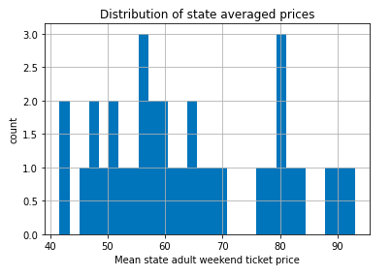
Exploring the Data
Big decision: It became clear that it is better to predict the adult weekend ticket price for ski resorts after dropping the wrong columns
Prices for each state were explored, no significant relationship was found.

Slide 6
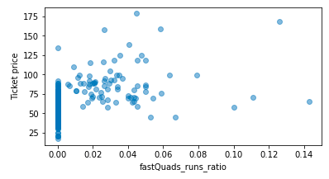
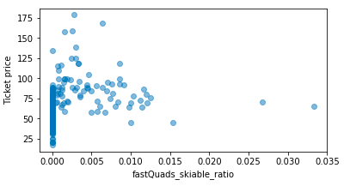
Exploring the Data
More columns with empty data together with state info were eliminated.
Merge was used to join the summary data for each fastQuad and skiing data as seen here

Slide 7
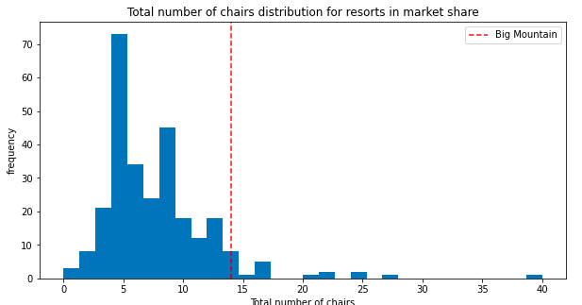
Preliminary Assessments
There is a significant increase in chair distribution for resorts in market share. This behavior is also seen in vertical drop[next slide]

Slide 8
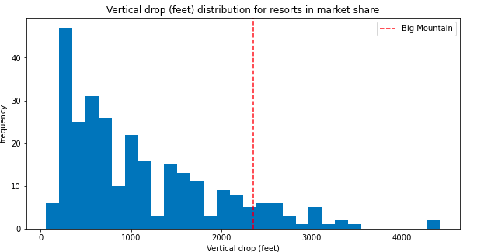
Preliminary Assessments
There is a significant increase in vertical in market share for about the same number of chairs

Slide 9
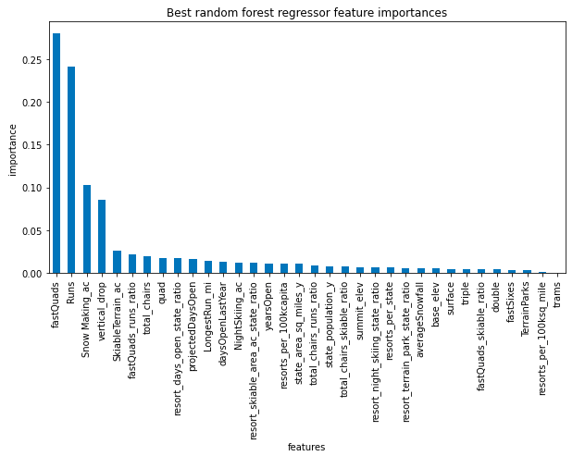
Chosing Model
First, linear model was made and compared with cross-validation and random forest.The dominant top four features of fastQuads,Runs,SnowMaking_ac,vertical_drop are in common with my linear model.

Slide 10
Summary
The random forest model was chosen because it has lower cross-validation mean absolute error by almost $1 compared to sample size of 40-50 leveling score by cross-validation model.
Adult tickets could be increased from $81 up to $90.
Increasing vertical drop to 150ft, and add new chairlifts.
If implemented, there will be a $3.2 million increase in revenue.
This model recommendation can be implemented using a structured dashboard.

